Slide 1
TL4 Presentation
CS 383 Software Engineering

Slide 2
What is a Gantt Chart
Oxford Dictionary definition:
Ø“a chart in which a series of horizontal lines shows the amount of work done or production completed in certain periods of time in relation to the amount planned for those periods.”
Main Goals
ØTrack Time
ØPlan Tasks
ØMonitor Future Tasks
ØPrioritize tasks
Benton

Slide 3
Why use a Gantt Chart?
Time Management
ØAllows you to track out and prioritize certain tasks for yourself and teammates.
Organization
ØA clean and organized way for you and your team to rank tasks
Communication
ØAll teammates have access to the chart allowing for straightforward communication of expectations
Benton

Slide 4
Why use a Gantt Chart? Cont.
Simplicity
ØWay to visually see the requirements and priorities of tasks of you and your teammates.
Allocation of Resources ($$$)
ØNot only can track hours but can track resource allocation for each task and workers hours
ØA good Gantt should be able to track work hours and expected work hours so budgets can be made and met
Benton

Slide 5
When You Should Use a Gantt
Like stated previously Gantt’s are used for project management and planning.
You should use a Gantt when:
Managing Projects
Ideally for a linear project where tasks are needed to be done sequentially before moving to the next
Managing Time of Projects
Managing Resources of a Project
Managing Deliverables of a Project
Benton

Slide 6
Gantt Chart Platforms
Choose a desired platform based on requirements. EX:
ØExcel (Most basic, Difficult to merge to GIT)
ØJira (Online, More dedicated Gantt services and symbols)
ØTeamGantt (Online hosted Gantt chart maker)
ØEtc.
Things to consider when picking a platform:
ØEase of use (Select a platform that you team will use and understand)
ØWhere this chart will be hosted.
ØMake sure all team members can access and add to the chart
ØWhat you need
ØDo you need tasks planned down to the hour, day. Do you need extra plugins?
Benton

Slide 7
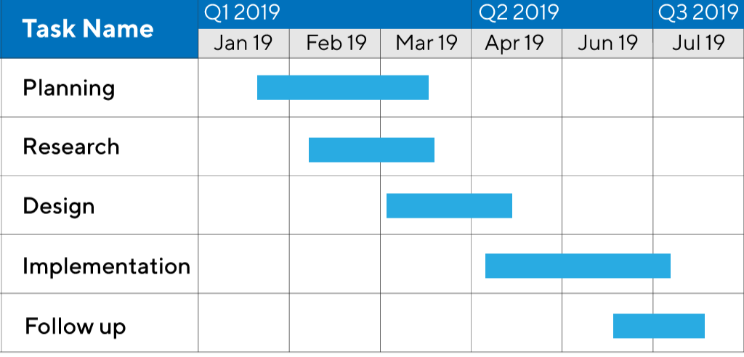
Example Gantt Chart
Notice
ØEach task is uniquely named for clarity purposes
ØEach task has its own timeline which might depend on previous tasks and other requirements
ØIt’s easy to follow and digest when things should be completed and when some should begin.
Benton

Slide 8
How to Add to a Gantt Chart
Define the task you are planning out. Note this under the task name section
Identify the estimated dedicated work hours to complete said task
Note of any prerequisite tasks that might delay the start of the task you are making
Place the task on the chart visually
If there is a pre task that delays the start of the task you are planning, make sure to account for this when placing on the diagram.
Benton

Slide 9
Using a Gantt Effectively in this Class
When you think about your feature think of everything that would lead up to it being complete.
ØPut all requirements as each of their own section on your team's master Gantt.
ØMake sure to also outline which tasks are dependent on others and make sure your Gantt follows this structure.
When you complete a task make sure to track this on your Gantt ASAP.
You can even use your Gantt to plan out later tasks to make sure you can dedicate the needed time and resources to complete the full project.
Benton

Slide 10
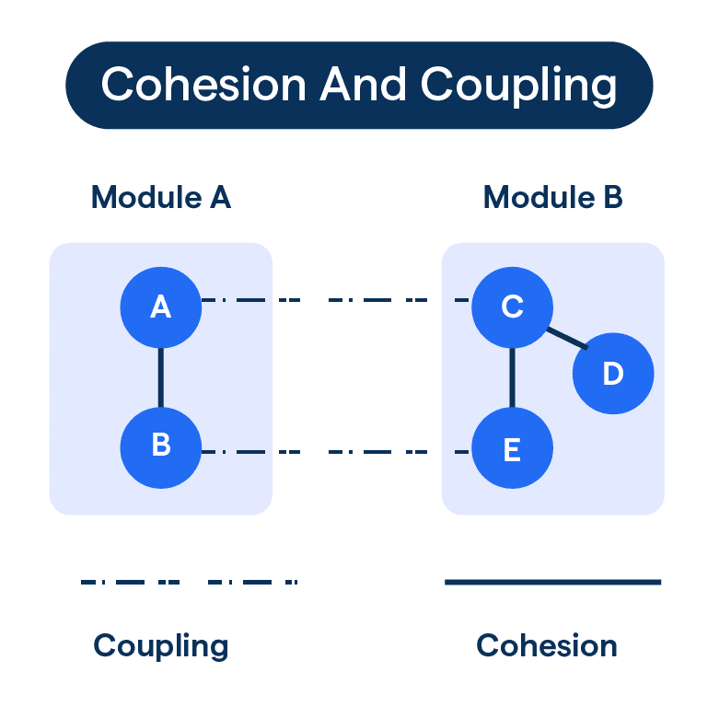
Coupling and Cohesion
Kate
Metrics to measure how logically sorted a set of functions is
Lower coupling is better, higher cohesion is better
WILL BE NEEDED for Postmortem presentation

Slide 11
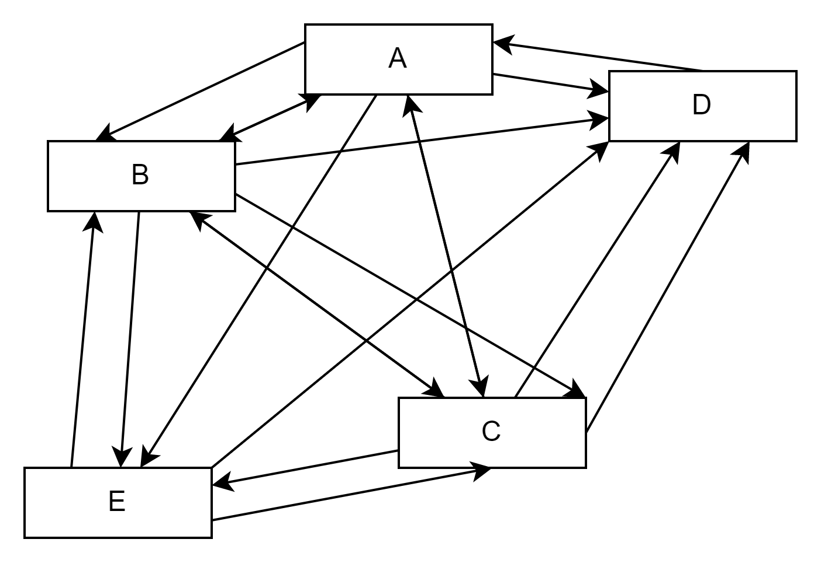
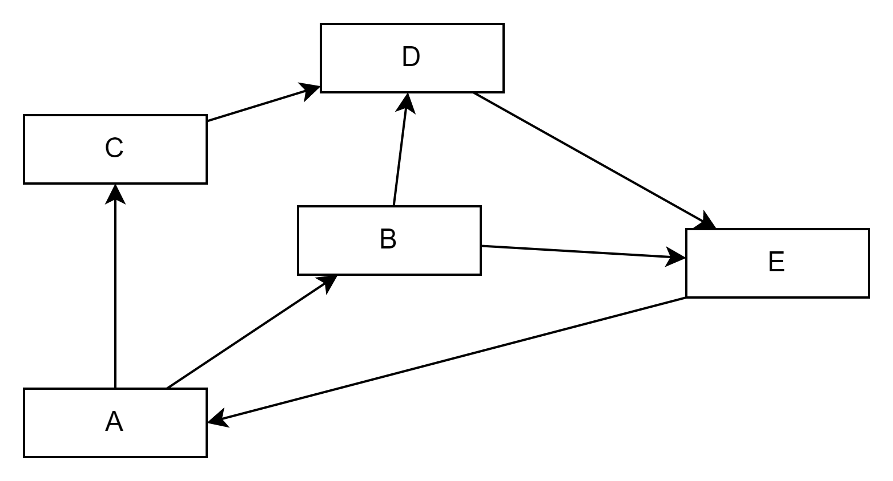
Coupling
the measure of the degree of interdependence between the modules
High Coupling
Low Coupling
High – strong interconnections where changes affect each other
Low – isolation between modules
Shan

Slide 12
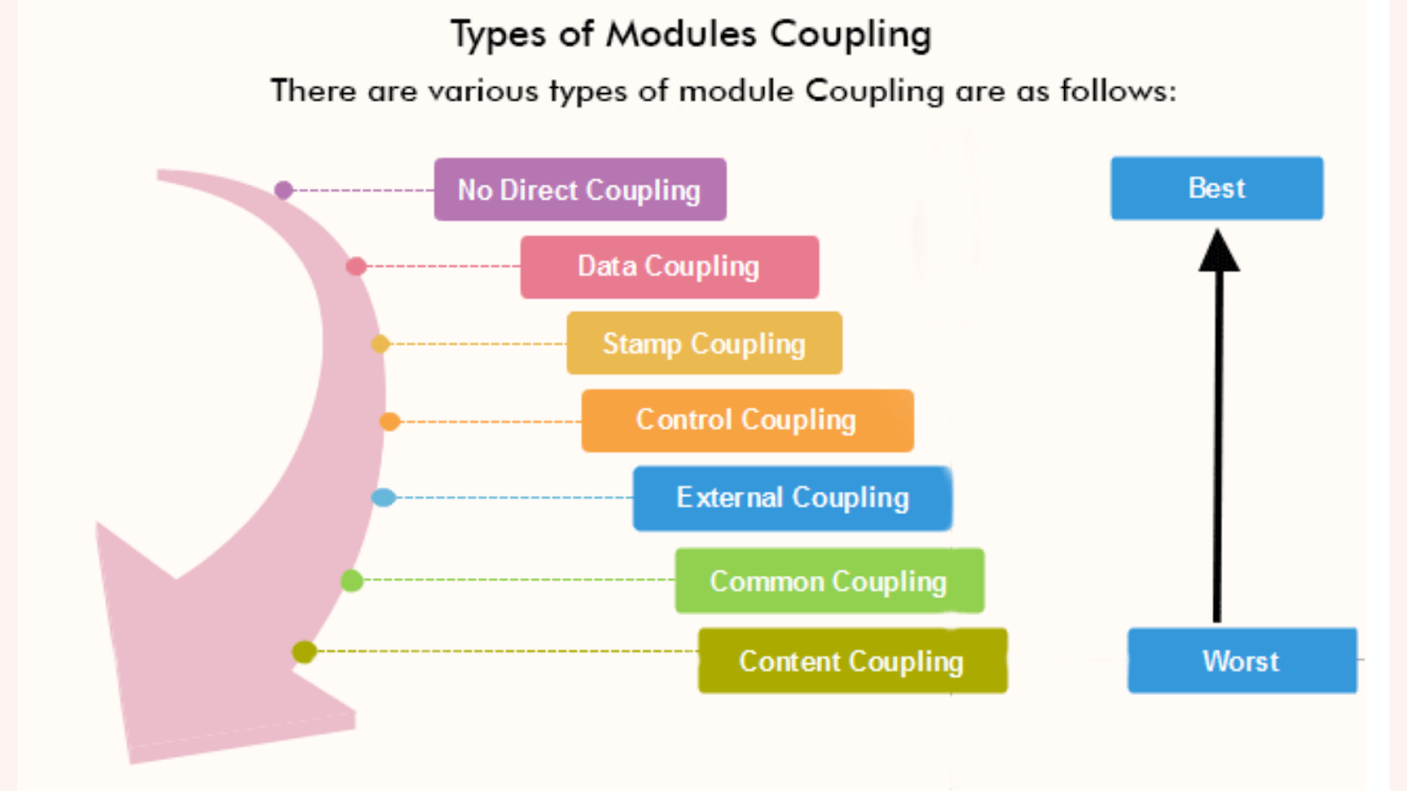
Coupling
Shan

Slide 13
Coupling
No Coupling:
Modules work w/o direct communication
Ideal type of connection
Minimizes impact of changes
Shan

Slide 14
Coupling
Data Coupling:
Modules communicate by passing necessary data
Components are close to independent of each other
Loose
Shan

Slide 15
Coupling
2. Stamp Coupling:
The complete data structure is passed from one module to another as a parameter and use parts
Changes to a structure can affect modules
3. Control Coupling:
One module controls another by passing control information
Ex. Sort function that takes comparison function as an argument
Shan

Slide 16
Coupling
4. External Coupling:
Modules communicate by exchanging data through external systems
Risky
5. Common Coupling:
Modules share same global data and resources
Used and modified by different modules
Disadvantage: difficulty in reusing

Slide 17
Coupling
6. Content Coupling:
One module relies on or can modify the internal details of another module
Strongest coupling
Worst form, should be avoided due to high dependencies

Slide 18
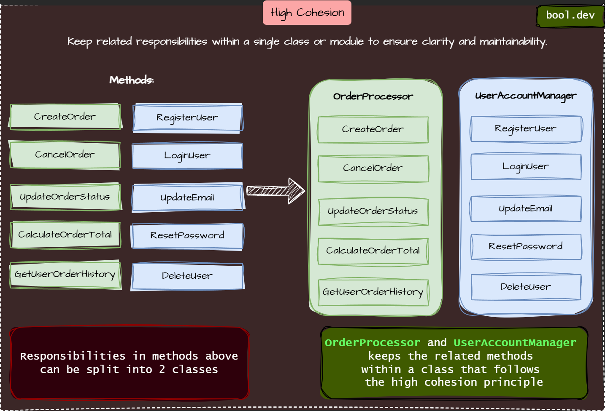
Cohesion
Kate
Degree to which elements in a module belong together

Slide 19
Cohesion
Kate
What:
Functionalities share significant similarities
Functions carry out a small number of related activities
Related functions are in the same source file or otherwise grouped together
Why:
Improved maintainability and reuse of components

Slide 20
Cohesion
Kate
Coincidental Cohesion
Functions share nothing in common besides being near each other
Logical Cohesion
Functions perform similar operations logically, despite having different underlying operations
Ex: Mouse and keyboard input in an InputHandler

Slide 21
Cohesion
Kate
Temporal Cohesion
Functions are called at the same or closely grouped times
Procedural Cohesion
Functions are called one after another in a fixed sequence
Informational Cohesion
Functions operate on the same data

Slide 22
Cohesion
Kate
Sequential Cohesion
Output from one function is chained to input in the next
Related to Procedural Cohesion
Functional Cohesion
Functions all contribute to a single well-defined task handled by the entire module

Slide 23
GRASP
General
Responsibility
Assignment
Software
Patterns

Slide 24
GRASP Patterns Description
Each GRASP pattern comes with:
Discussion
Contradiction
Benefits
Related Patterns or principles
Some key notes about these GRASP patterns:
These patterns provide advice on assignment and responsibilities
Patterns may conflict each other in advice
So we must use best judgment when applying certain/multiple patterns
The extra sections will help us with this
This work is not mechanical!

Slide 25
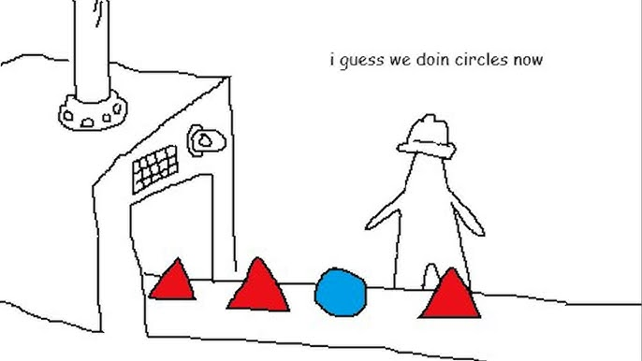
GRASP Pattern - Information Expert
Zach
"Assign a responsibility to the class that has the necessary information to fulfill it, promoting high cohesion and minimizing coupling"
High Coupling – Interdependence
High Cohesion – Independence
The Information Expert pattern avoids the issue within the triangle factory.

Slide 26
GRASP Information Expert
Zach
Question – What is a General principle of assigning responsibilities to objects?
Solution – Assign responsibilities to an "Expert Class" which is a class with the information to complete the task.
Don't assign circle creation to the TriangleFactory class.

Slide 27
GRASP Information Expert
Zach
Benefits
Encapsulates data well
Class behavior is spread across smaller lightweight classes
Detriments
Can lower cohesion by adding responsibility to a class
Can raise coupling if the added responsibility requires communication with a separate module
Varying levels of coupling and cohesion aren't inherently bad, but consider how it should be used given your context

Slide 28
GRASP Information Expert
Zach
How to implement
Use private methods and variables
Reduce data sharing between different modules (when applicable)
Approach coding with these principles in mind;
With a task in mind, will this lower coupling, or raise it?
It's much easier to start with principles in mind than to fix conflicts

Slide 29
GRASP Information Expert
Zach
// ❌ Factory has too much responsibility
class ShapeFactory {
public static Object createShape(String type, double... dimensions) {
if (type.equalsIgnoreCase("triangle")) {
return new Triangle(dimensions[0], dimensions[1]);
} else if (type.equalsIgnoreCase("circle")) {
return new Circle(dimensions[0]);
} else {
throw new IllegalArgumentException("Unknown shape type");
}
}
}
// ✅ The factory now delegates responsibility to the expert classes
class ShapeFactory {
public static Shape createShape(String type, double... dimensions) {
switch (type.toLowerCase()) {
case "triangle":
return Triangle.create(dimensions[0], dimensions[1]);
case "circle":
return Circle.create(dimensions[0]);
default:
throw new IllegalArgumentException("Unknown shape type");
}
}
}

Slide 30
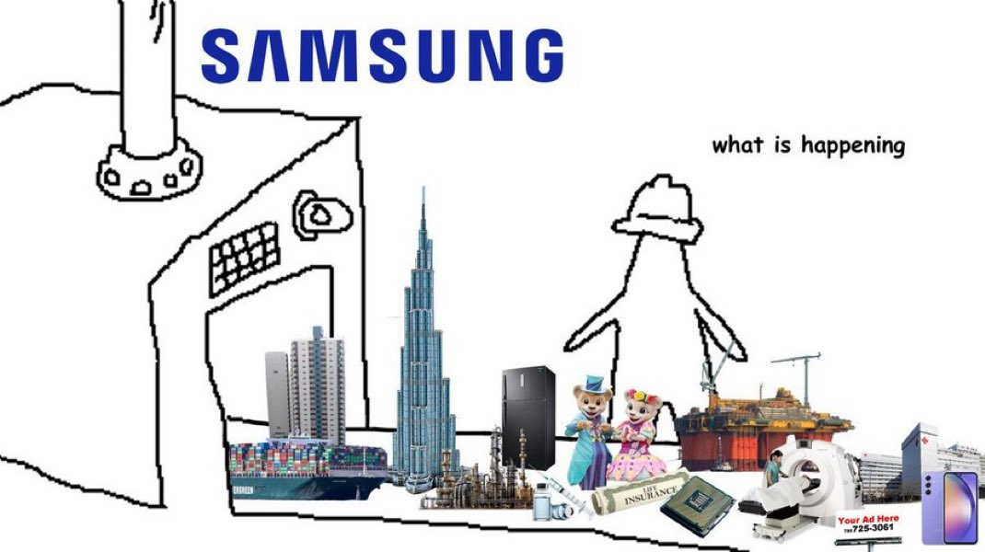
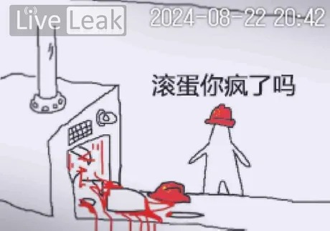
GRASP Information Expert
Zach
Don’t put your group through this:

Slide 31
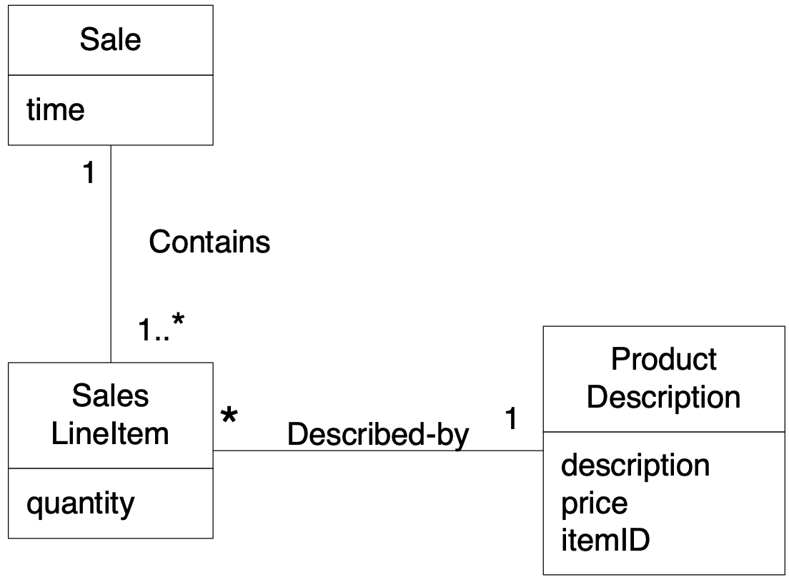
GRASP Pattern – The Creator
Problem "The Creator" Addresses: Who is able/allowed to create a new instance of some class.
Example: Who's responsible for creating "SalesLineItem" class?
In OO programming the creation of objects is the one of the most common activities
So the need for "The Creator" is evident. The specific aims of the creator are to achieve:
Low coupling
Increased clarity
Increased encapsulation
Increased reusability
Benton
Notes:
The creation of objects is one of the most common activities in an object-oriented system.
Consequently, it is useful to have a general principle for the assignment of creation
responsibilities. Assigned well, the design can support low coupling, increased clarity,
encapsulation and reusability.
The basic intent of the
Creator pattern is to find a creator that needs to be connected to the created object in any event.
Creator Problem: Assign responsibility for creating a new instance of some class?
Solution: Determine which class should create instances of a class based on the relationship between potential creator classes and the class to be instantiated.
-----------------------------------------
Creator guides assigning responsibilities related to the creation of objects. The basic intent of the
Creator pattern is to find a creator that needs to be connected to the created object in any event.
The concept of aggregation is used in considering the Creator pattern. Aggregation involves things
that are in a strong Whole-Part or Assembly-Part relationship, such as Body aggregates Leg or
Paragraph aggregates Sentence. Aggregate aggregates Part, Container contains Contents, and
Recorder records Recorded are all very common relationships between classes in a class diagram.
The only guideline of the Creator is that the enclosing container or recorder class is a good candidate
for the responsibility of creating the thing contained or recorded.
Sometimes a creator is found by looking for the class that has the initializing data that will be passed
in during creation. This is actually an example of the Expert pattern. Initializing data is passed in
during creation via some kind of initialization method, such as a Java constructor that has
parameters.

Slide 32
GRASP Creator
Problem:
Who's responsible for creating a new instance of some class?
Solution:
Assign class B the responsibility to create an instance of class A if AT LEAST ONE of these is true:
B "contains" or compositely aggregates A.
B records A
B closely uses A
B has initializing data for A (i.e., B is and Expert with respect to creating A)
Benton
Notes:
17. 17 Creator
who has responsibility to create an object?
•By creator, assign class B responsibility of creating instance of class A if
•B aggregates A objects
•B contains A objects
•B records instances of A objects
•B closely uses A objects
•B has the initializing data for creating A objects
where there is a choice, prefer
•B aggregates or contains A objects
18. 18 Creator : Example Who is responsible for creating SalesLineItem objects?
Look for a class that aggregates or contains SalesLineItem objects.

Slide 33
GRASP Creator
Discussion:
Intent is to support low coupling (i.e. creator is found that already needs to be connect to created object)
Initializing data is sometime indicator of a good Creator
Some object constructors have complex signatures
Which objects have the information needed to supply parameter values for such constructors?
Contradictions:
Creation can be complex (recycled instances, creating an instance from a family of similar classes)
May wish to use Factory Method or Abstract Factory instead in these cases
Benton
Notes:
5.1.2.4.Contraindications
Often, creation requires significant complexity, such as using recycled instances for performance
reasons, conditionally creating an instance from one of a family of similar classes based upon some
external property value, and so forth. In these cases, it is advisable to delegate creation to a helper
class called a Factory rather than use the class suggested by Creator.

Slide 34
GRASP Creator
Benefits:
Low coupling is supported, which implies lower maintenance dependencies and higher opportunities for reuse
Why is this good?
Related Patterns or Principles:
Low coupling
Factory Method and Abstract Family
Whole-Part pattern: defines aggregate objects that support encapsulation of components
Benton
Notes:
5.1.2.3.Benefits
Low coupling is supported, which implies lower maintenance dependencies and higher opportunities
for reuse. Coupling is probably not increased because the created class is likely already visible to the
creator class, due to the existing associations that motivated its choice as creator.

Slide 35

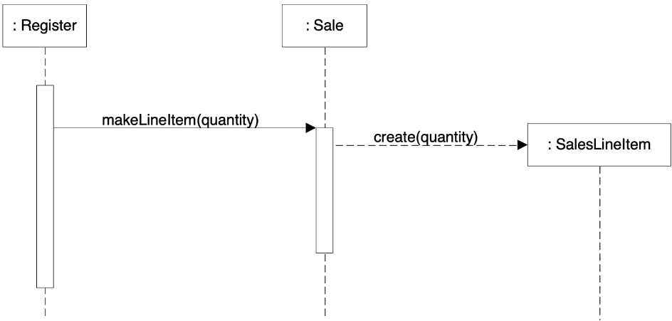
GRASP Creator
Sale will contain many SalesLineItem objects
Creator GRASP pattern suggests Sale is one object that could fulfill this responsibility
Consequences:
MakeLineItem becomes a method in Sale. We capture this decision in our UML model diagrams.
Benton
Notes:
Who should be responsible for creating a SalesLineltem instance? By Creator, we should look for a
class that aggregates, contains, and so on, SalesLineltem instances. Since a Sale contains (in fact,
aggregates) many SalesLineltem objects, the Creator pattern suggests that Sale is a good candidate to
have the responsibility of creating SalesLineltem instances.
This leads to a design of object interactions as shown in the sequence diagram on the bottom.
This assignment of responsibilities requires that a makeLineltem method be defined in Sale. The
method section of a class diagram can then summarize the responsibility assignment results,
concretely realized as methods.

Slide 36
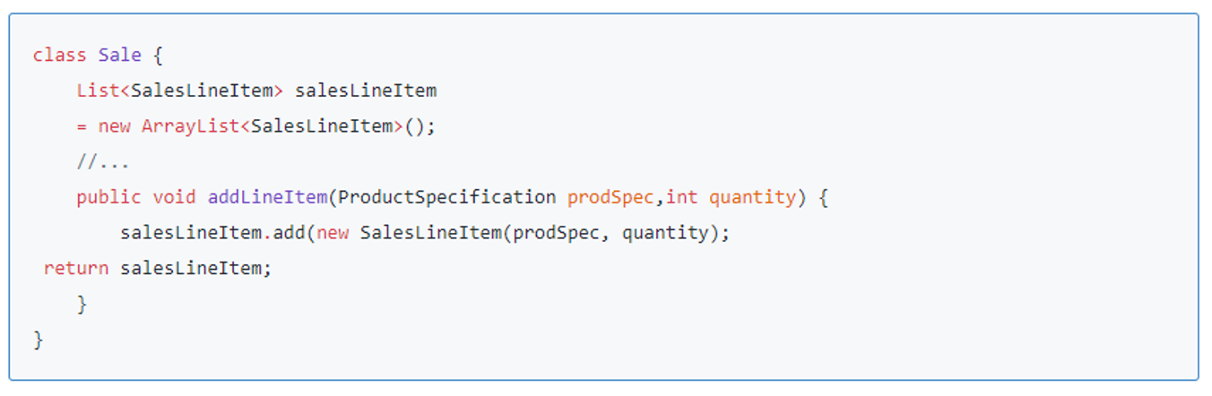
GRASP Creator
Source: https://www.sourcecodeexamples.net/2018/06/creator-grasp-pattern.html
As you can see the addLineItem has now become a method in the Sales class. This means that the Sale class has now become the creator of the addLineItem method and is able to call and create objects whenever.
Benton

Slide 37
GRASP Pattern - Polymorphism
What is Polymorphism in GRASP?
A principle that allows objects to be treated as instances of their parent class rather than their actual class.
Helps in designing systems where behavior varies depending on object type without modifying existing code.
Encourages loose coupling and scalability.
Jeffrey

Slide 38
GRASP Polymorphism
Problem Addressed by Polymorphism
How do we handle different behaviors for related types without conditional logic?
Avoiding large `if-else` or `switch` statements when handling multiple object types.
Solution
Define a common interface or abstract class for related behaviors
Allow subclasses to override and implement specific behavior
Delegate responsibility to the correct subclass dynamically
Jeffrey

Slide 39
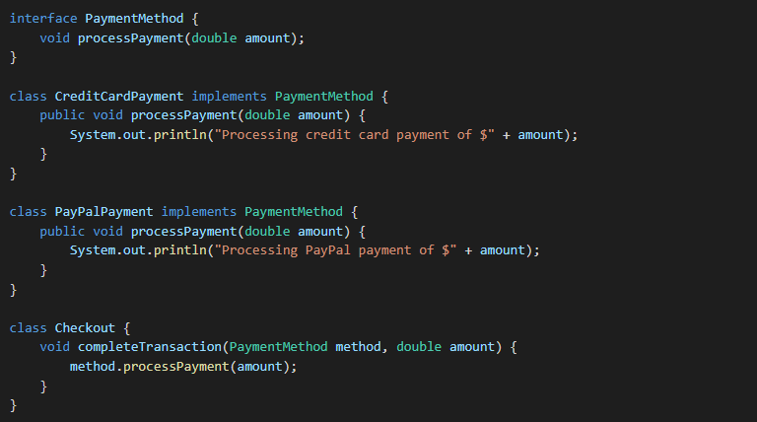
GRASP Polymorphism
An Example
The `Checkout` class does not need to check which payment method is used; it simply calls `processPayment`
Jeffrey

Slide 40
GRASP Polymorphism
Discussion
Using polymorphism enables designing flexible and scalable systems.
It reduces redundancy and simplifies code maintenance by centralizing behavior in a common superclass or interface.
Ensures that new behaviors can be added without modifying existing code, supporting the Open/Closed Principle.
However
Contradictions
It can introduce unnecessary complexity if overused
May lead to improper class hierarchies where behavior does not logically belong to subclasses.
Overuse can make debugging difficult due to increased abstraction layers
Jeffrey

Slide 41
GRASP Polymorphism
Benefits of Polymorphism in GRASP
Reduces coupling between classes.
Simplifies code maintenance and extensions.
Encourages modularity and reusability.
Enhances code flexibility by allowing objects to be used interchangeably.
Supports design principles such as Open/Closed Principle and Dependency Inversion.
Jeffrey

Slide 42
GRASP Polymorphism
Related Patterns
Indirection: Delegates responsibility to an intermediary
Protected Variations: Uses stable interfaces to shield against change
Information Expert: Assigns behavior to the most knowledgeable class
Jeffrey

Slide 43
GRASP Pattern - Protected Variations
Problem: How do we create our system in a way where we can change something in one place and still retain functionality of the system?
Solution: Organize responsibilities around stable interfaces
Shan

Slide 44
GRASP Protected Variations
Interfaces
Type of abstract contract that describes what a class can do
Actual implementation is left to class
Ex. Must have a GetData() function
Separate points of instability (susceptible to change) from rest of code
Benefits
Isolates changes, making the system more robust and easier to modify
Good for code that changes often
Low coupling
Shan

Slide 45
GRASP Protected Variations
Discussion:
Intended to design the system to protect against variations or changes that may affect other parts of the code
Contradictions:
Over-Abstraction – too complex, low readability
Abstractions could become unstable themselves
Shan

Slide 46
GRASP Protected Variations
Related Patterns
Low coupling – minimize dependencies between objects
Open/Closed Principle from SOLID
Software entities should be open for extension but closed for modification
Shan

Slide 47
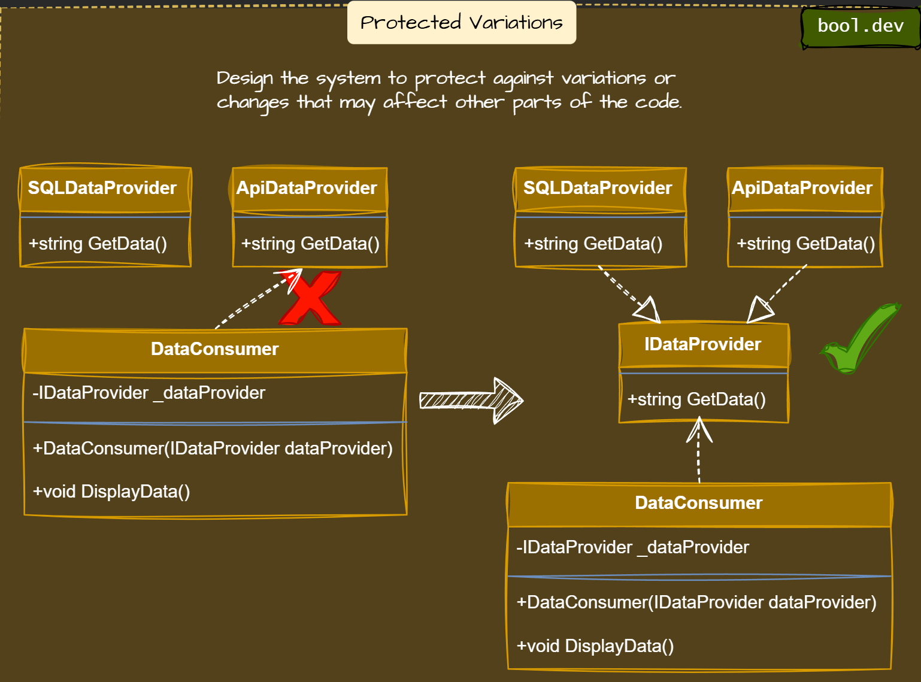
Shan

Slide 48
GRASP Pattern – Controller
Kayra
Problem:
What should be responsible for handling an input system event?
Solution:
Assign responsibility to a class based on:
Class is "the root" object that represents the overall system
A new class responsible for handling a specific user interaction

Slide 49
GRASP Controller
Kayra
A controller object is a non-user interface object responsible for receiving and handling a system event.
Benefits
Separation of concerns
Improves reusability, maintainability, and scalability
Supports testability – does not require user interaction

Slide 50
GRASP Controller
Kayra
How the controller works
The UI triggers a system event
sent by a button click or a request
A controller object is responsible for handling that event
The controller delegates tasks to domain objects
The controller returns a response to the UI

Slide 51
GRASP Controller
Kayra
Discussion
Intended to assign the responsibility of handling a user input to a non-UI class and act as an intermediary between the UI and the business logic
Contradictions
Increased complexity
Tight coupling: when two or more classes/components are highly dependent on each other

Slide 52
GRASP Controller
Kayra
Related Patterns
Information expert – ensures correct delegation
Low coupling – keeps the system modular and maintainable

Slide 53
GRASP Pattern – Pure Fabrication Sikha
Problem: How do we assign responsibilities when no natural class seems to be the right choice?
Solution: Create a Pure Fabrication class, a class that does not represent a real-world entity but is introduced to handle a specific responsibility. This helps achieve low coupling, high cohesion, and separation of concerns.

Slide 54
GRASP Pure Fabrication
Discussion:
The pattern is used to encapsulate behaviors that don’t belong to any domain object.
It helps separate technical concerns from the business logic of the system.
A fabricated class may perform tasks like logging, encryption, or persistence.
Contradictions:
Overuse can lead to too many artificial classes, increasing complexity.
Might introduce unnecessary layers, making debugging harder.

Slide 55
GRASP Pure Fabrication
Benefits:
Reduces coupling by keeping domain objects focused on their core responsibilities.
Increases cohesion by grouping related behaviors into separate, manageable classes.
Enhances reusability, making it easier to use the fabricated class across different parts of the system.

Slide 56
GRASP Pure Fabrication
Related Patterns:
Indirection – Delegating responsibility to a mediator to lower coupling.
Low Coupling – Minimizing dependencies between objects.
Facade Pattern – Providing a unified interface to a set of interfaces in a subsystem.

Slide 57
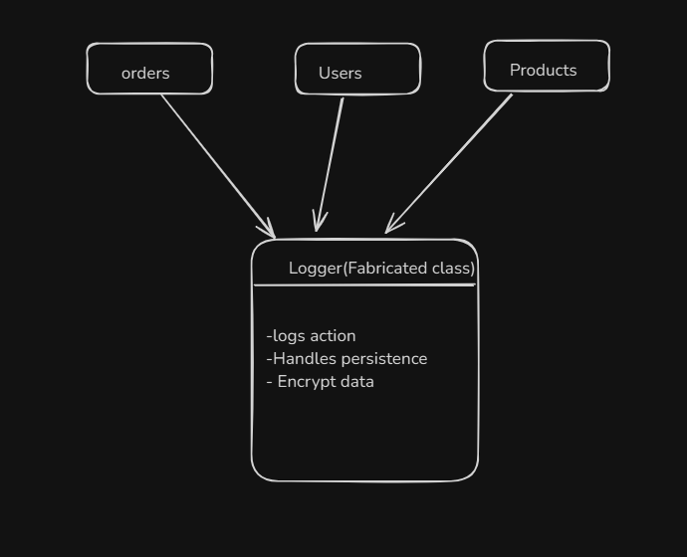
GRASP Pure Fabrication

Slide 58
GRASP Pattern - Indirection
Problem:
Where are responsibilities assigned if we want to avoid direct coupling between two or more things?
Solution:
Add an intermediary object with responsibility to mediate between two or more components.

Slide 59
GRASP Indirection
Discussion
Adding intermediaries gives code a "middle-man" between two programs.
Organizes details and variations into a common abstraction.
Contradiction
Adding intermediaries can affect the memory and performance usage of a program.

Slide 60
GRASP Indirection
Benefits
Improved reusability of code.
Code is easily maintainable and adaptable.
Changes can be made without affecting an entire system.

Slide 61
GRASP Indirection
Related Patterns:
Low coupling: reducing interconnectedness of objects.
Polymorphism: encouraging scalability.

Slide 62
GRASP Pattern - High Cohesion
Problem:
Which functionality should be placed in which classes?
Solution:
Closely related functions should be placed in the same class
Unrelated functions should be fragmented into different classes
Kate

Slide 63
GRASP High Cohesion
Benefits:
Easy to locate specific functions if all functions are well-sorted into classes
Classes do not need to rely too heavily on internal specifics of other classes, making modifications or replacements easier
Drawbacks:
The same function might be related to multiple different sets of functionality
Kate

Slide 64
GRASP High Cohesion
Exceptions
We might want shared umbrellas for functions which are individually too small to warrant an entire class.
In those cases, an XYZHelper class which contains a large number of low-cohesion miscellany which can't be fit anywhere else is acceptable.
Related Patterns
Cohesion and coupling are the same phenomenon, but within and between classes respectively
Kate

Slide 65
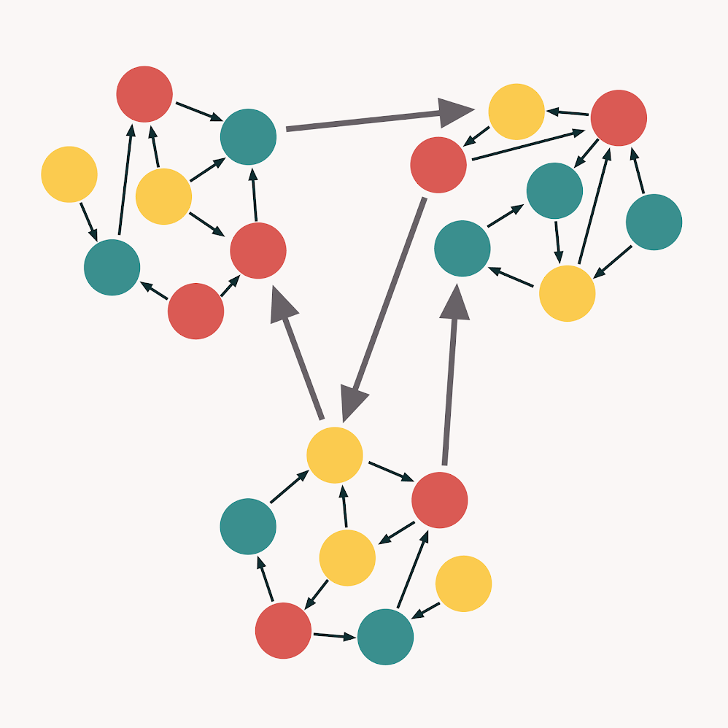
GRASP High Cohesion
Kate
Example
Modules depend primarily on their own subcomponents
Dependence on internals of other modules is minimized

Slide 66
GRASP Pattern – Low Coupling
Problem: How do we handle high dependency and increased reuse of our code?
Solution: Minimize dependencies between classes to reduce the impact of changes.
Shan

Slide 67
GRASP Low Coupling
Discussion
As few connections as possible between our classes, modules, files, etc.
Benefits
Code easier to update and maintain
Efficient, reusable, understandable
The fewer connections, the more stable the system
Shan

Slide 68
GRASP Low Coupling
Contradictions
Some dependencies are unavoidable - calling a function
Avoid connection if not needed
Related Patterns
Related to all other patterns
Creator – will only have connections where the created object will be used (where required)
Shan

Slide 69
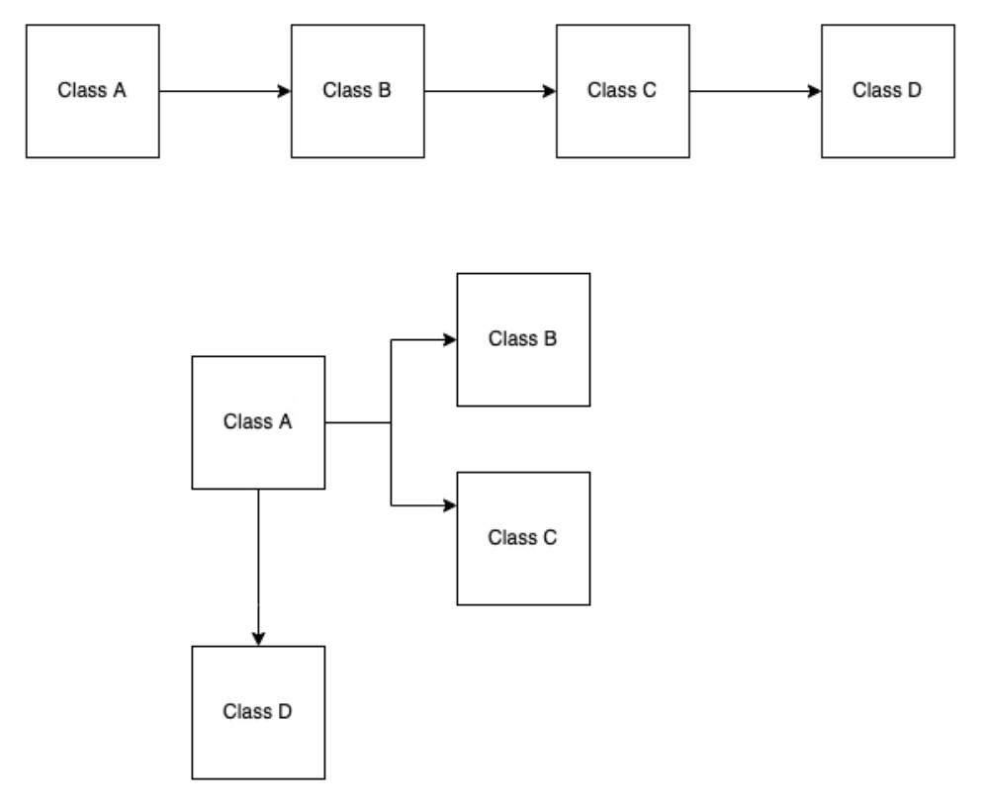
GRASP Low Coupling
Shan

Slide 70
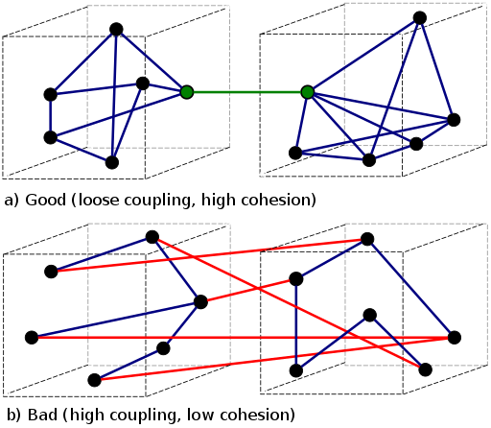
GRASP Low Coupling
Shan

Slide 71
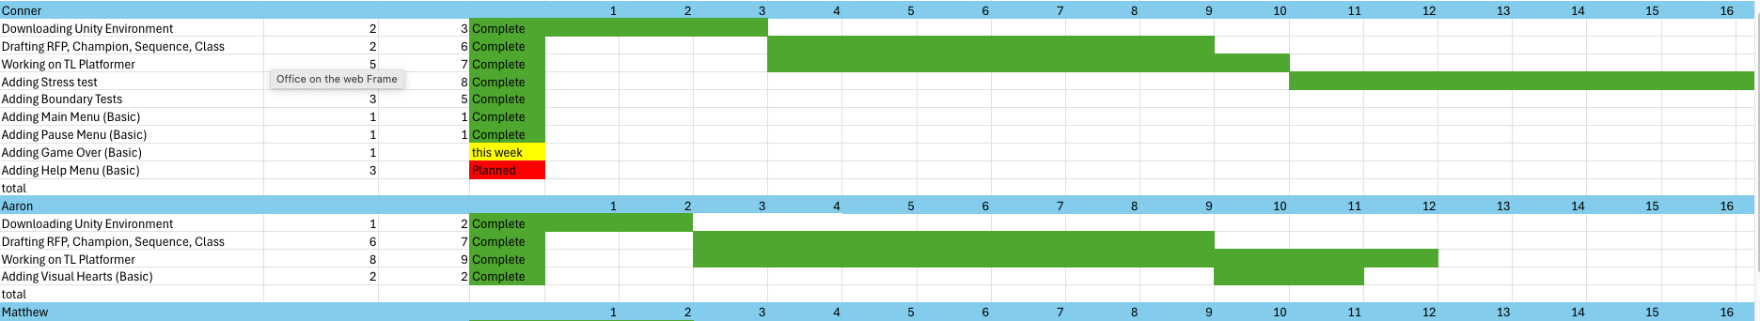
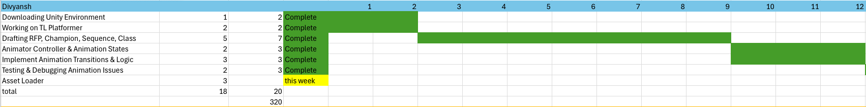
Gantt Roast – Kirklind Signature
It looks like Aaron might be falling behind if we were looking just at the Gantt chart, compared to others.
Seems as though this team member does not have any features planned for the future. Is this a correct assumption?

Slide 72
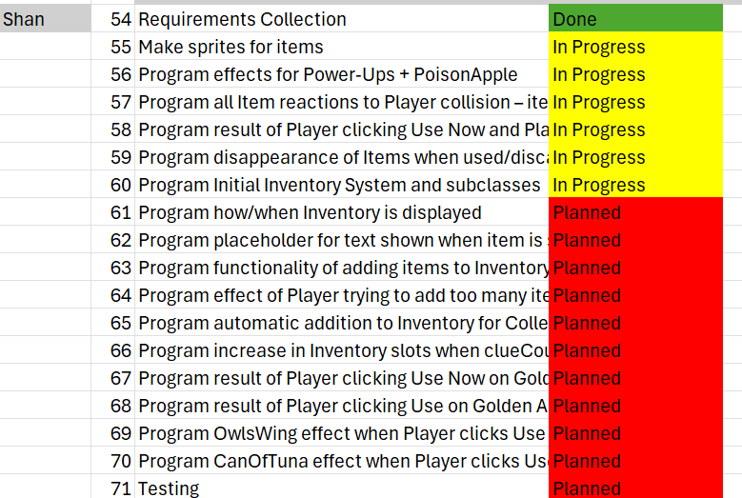
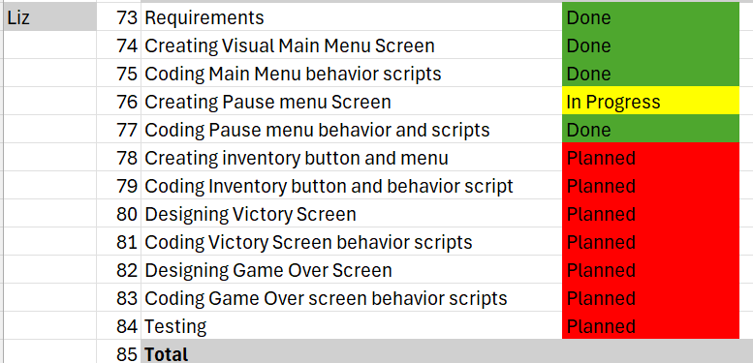
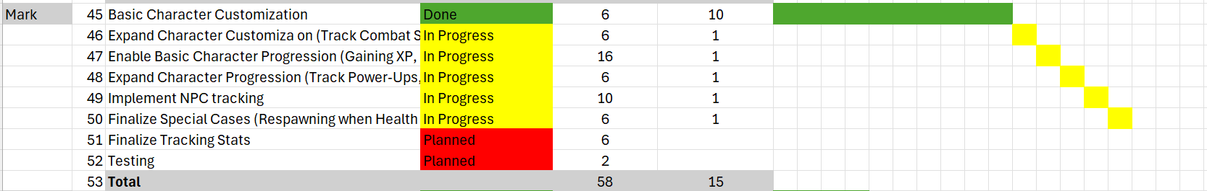
Gantt Roast – Green Sky Games
Wouldn't there be low cohesion if Shan is doing inventory instead of Liz?
Looks like Mark has very few tasks listed. Will this be an issue moving forward?

Slide 73
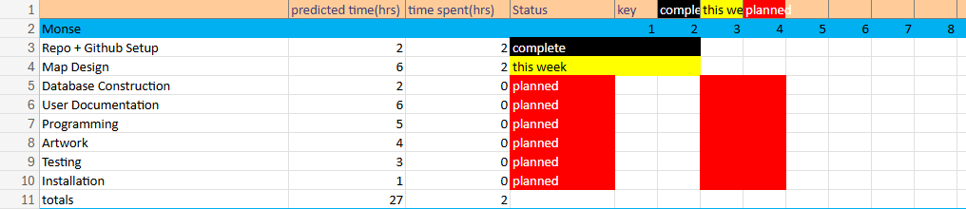
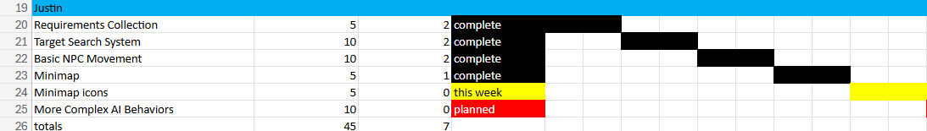
Gantt Roast - defaultCompany
Improper layout, lower time use than other team members. Might be falling behind?
Suspiciously low time uses for everything to be complete. MVP is not the same as being finalized.
If data is accurate, will Justin have enough tasks left for the remainder of the semester?

Slide 74
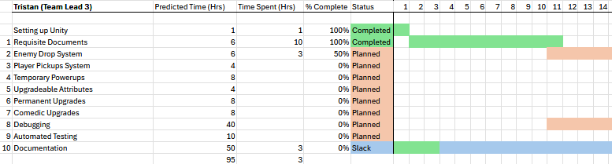
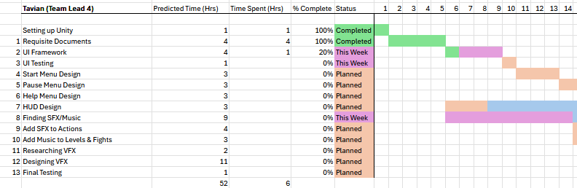
Gantt Roast - Glorbos
Why are these individual hours low? Perhaps behind on updating?

Slide 75
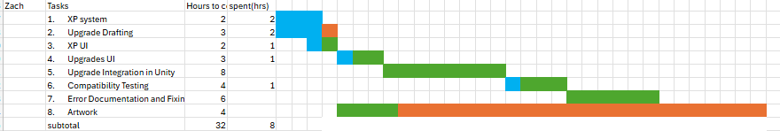
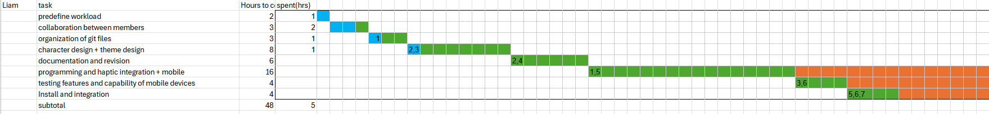
Gantt Roast – SuperNova Games
No planned, current, and completed tab. Completed sections don’t follow prerequisites.
Not too many hours completed, slack doesn't match the prerequisites, 6 must be completed before 8 begins. (don’t let your pipe burst next time, 10 minutes late to presentation unforgivable)

Slide 76
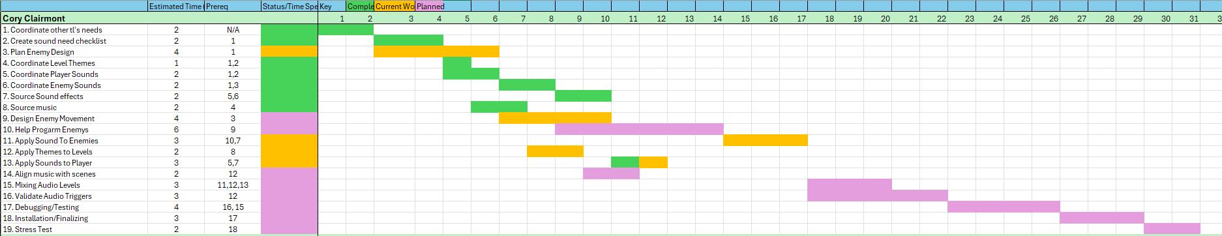
Gantt Roast – Brain Stew
Cory's third task hasn't been completed yet, however it may be due to roadblocks encountered during that allotted dev time period
Kayra is possibly falling slightly behind, not too much progress made here

Slide 77
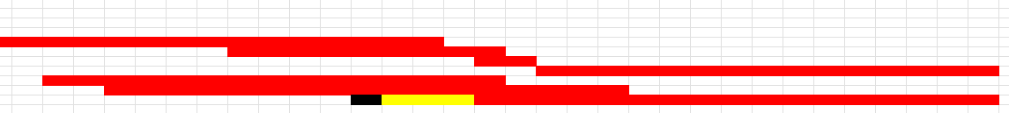
Gantt Roast – Spaghetti Studio
Jeffrey may be falling behind, and the colors hurt my eyes
Garrett's gantt chart shows that he started working on two tasks where one depends on the other's completion

Slide 78
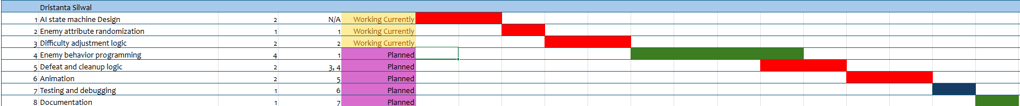
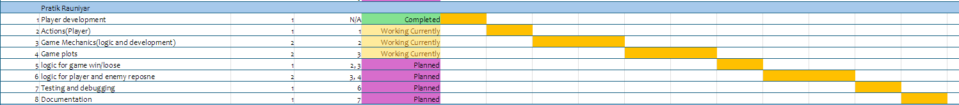
Gantt Roast- Cyber Titans
Dristanta has not completed any of his task, might be falling behind.
Pratik is working on too many features at once but not too much progress.

Slide 79
References
https://hackernoon.com/grasp-principles-part-3-polymorphism-pure-fabrication-indirection-protected-variations
https://medium.com/huawei-developers/grasp-principles-that-every-developer-should-know-81d44c684ef9
https://www.fluentcpp.com/2021/06/23/grasp-9-must-know-design-principles-for-code/
https://bool.dev/blog/detail/grasp
https://users.cs.utah.edu/~germain/PPS/Topics/interfaces.html
https://www.geeksforgeeks.org/grasp-design-principles-in-ooad/
https://medium.com/wix-engineering/what-exactly-does-low-coupling-high-cohesion-mean-9259e8225372
https://www.geeksforgeeks.org/software-engineering-coupling-and-cohesion/
https://www.engati.com/glossary/cohesion-and-coupling
https://hackernoon.com/grasp-principles-part-2-controller-low-coupling-and-high-cohesion
https://www.scaler.com/topics/cohesion-and-coupling-in-software-engineering/

